Slide 1
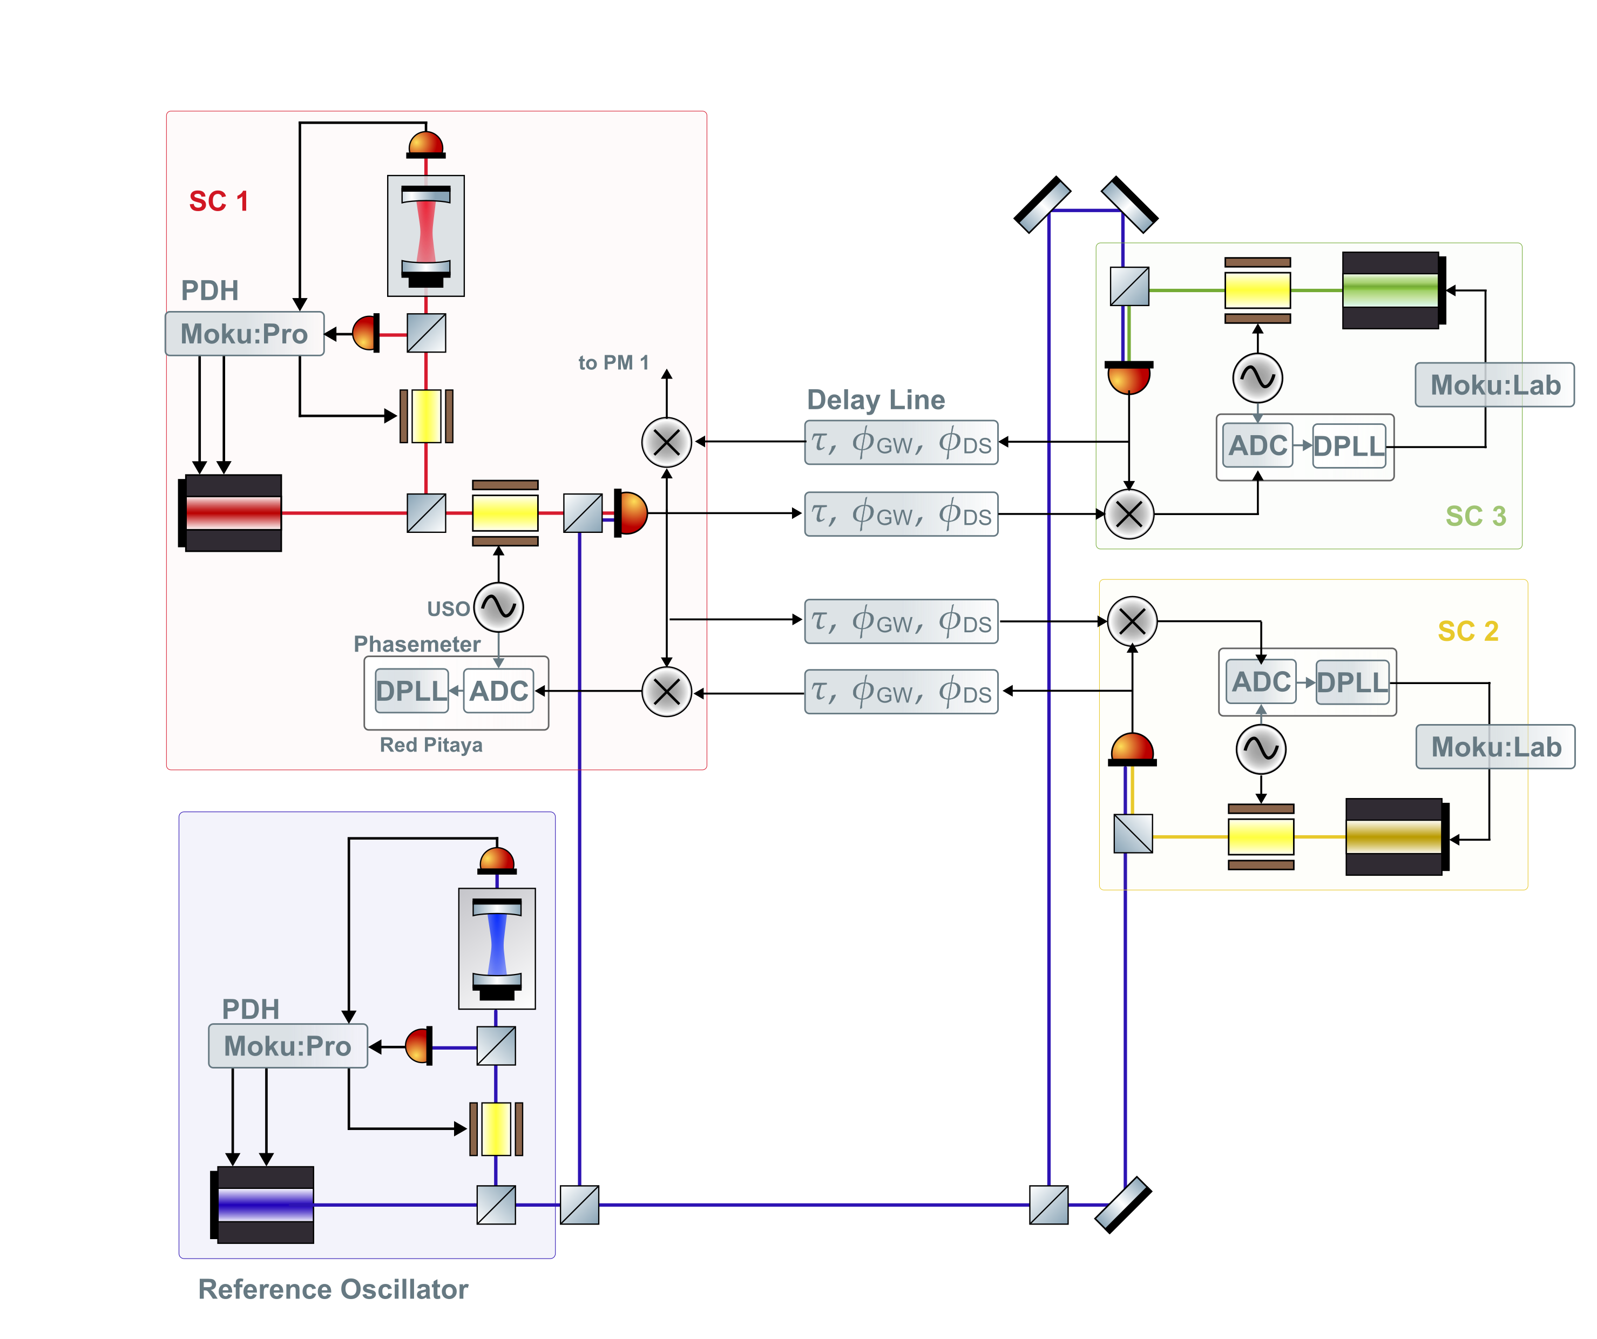
miniLISA setup
LISA-like EOMs
The 3 LISA-like EOMs are used to produce the sideband-sideband beatnotes.
We will separately have 2 EOMs for the phase modulation needed for the PDH locking.

Slide 2
Frequency ranges needed for the EOMs
LISA uses broadband fiber-coupled EOMs
GHz sidebands, PNR at MHz (?), data transfer at kHz (?)
miniLISA
MHz sidebands (for now ?)

Slide 3
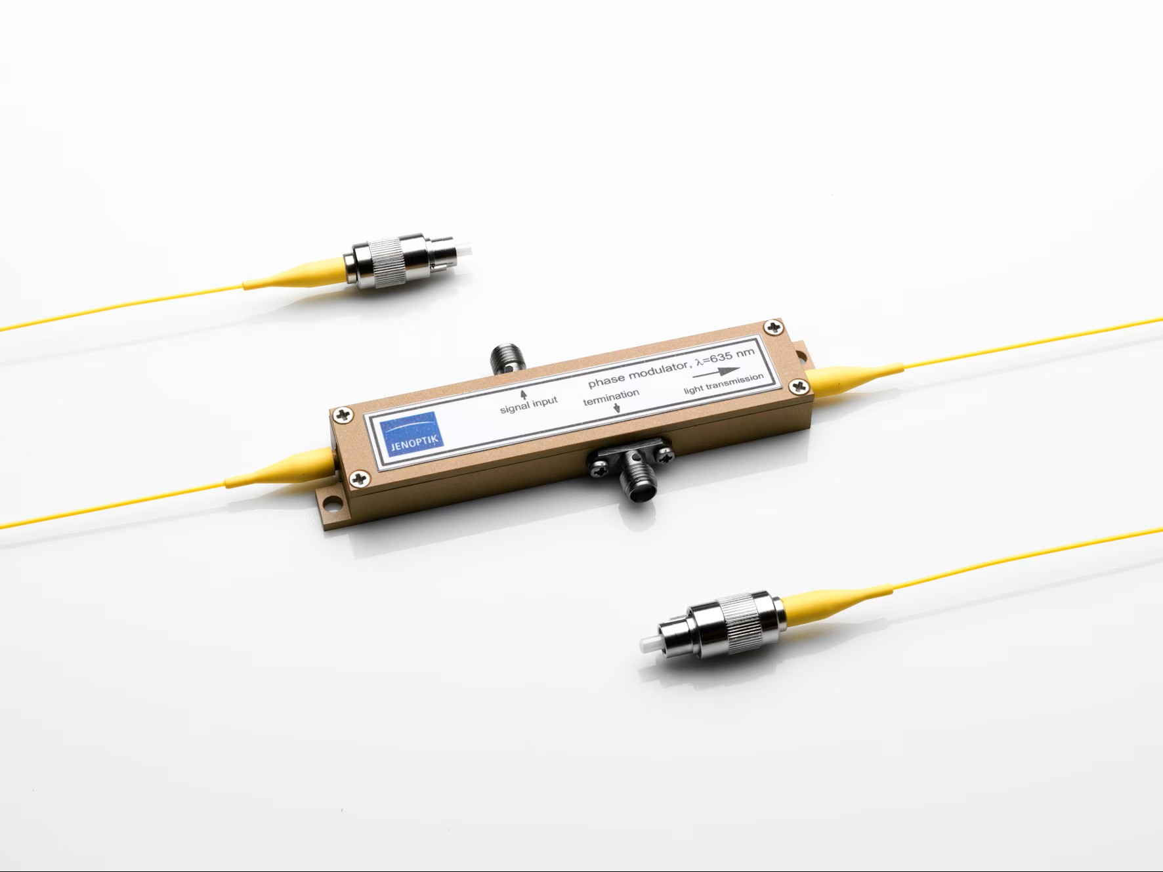
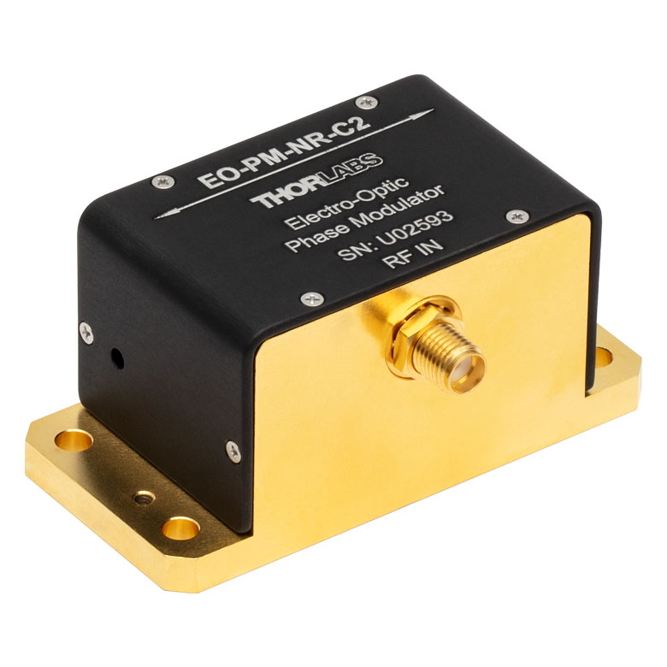
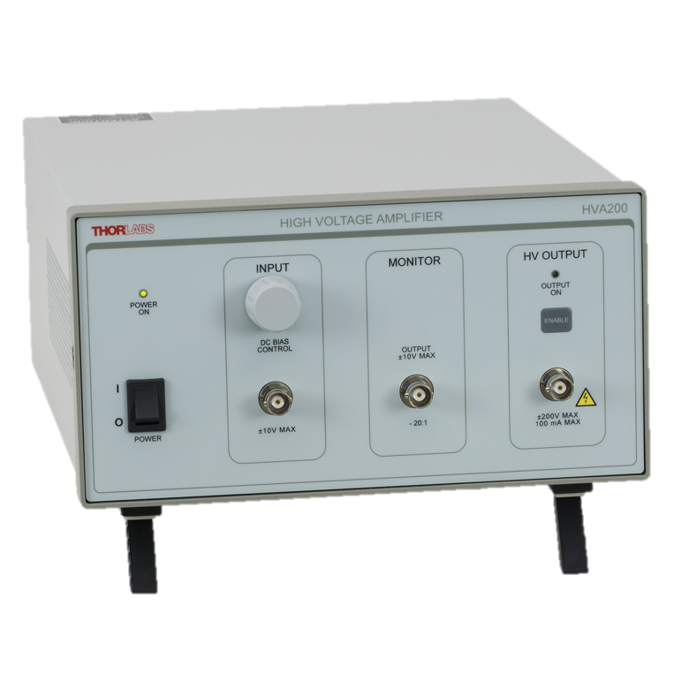
Free-space vs fiber-coupled EOMs
Free-space (broadband) | Fiber-coupled (broadband) | Verdict
No fibers | Fiber noise? | Shouldn’t be a big difference hopefully
Needs steering mirrors | Doesn’t need steering mirrors | Free space needs more room
High half wave voltage (needs amplifier) | Low half wave voltage | Free-space needs more room (and money?)
Not as LISA-like | LISA-like | Being LISA-like in this regard isn’t that important for now
- | Jenoptik EOM has been measured to be below LISA requirement
 | Option to reduce residual RAM noise
 | Parasitic reflections (an unwanted cavity)
2.5K EUR
2.5K EUR

Slide 4
PDH EOMs
Resonant EOMs should be fine, just need to decide on the frequencies
20 MHz?
Free-space should be fine here?
Even though it will take up a bit more room on the table

